Slide 1
Chapter 15
Injuries to the Thigh, Leg and Knee

Slide 2
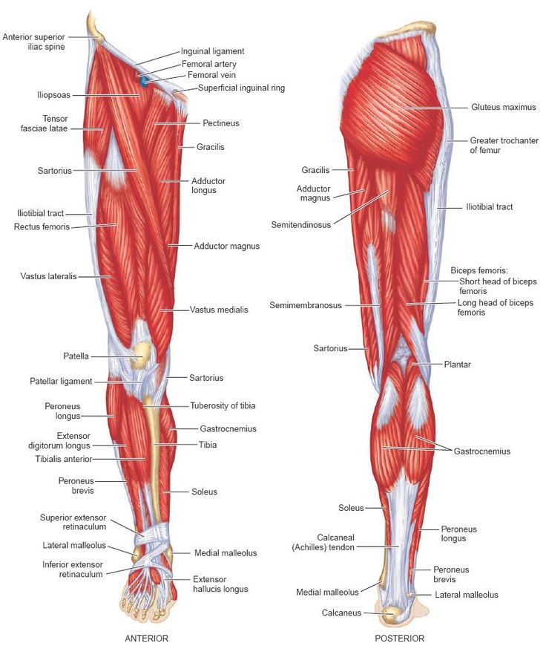
Anatomy

Slide 3
Anatomy
Muscle Group | Muscle Name | Actions
Quadriceps | Rectus femoris | Knee extension, hip flexion
(anterior thigh) | Vastus medialis | Knee extension
 | Vastus intermedius | Knee extension
 | Vastus lateralis | Knee extension
Hamstrings | Biceps Femoris | Knee flexion
(posterior thigh) | Semimembranosus | Knee flexion
 | Semitendinosus | Knee extension
Adductors | Adductor longus | Thigh adduction
 | Adductor magnus | Adduction
 | Adductor brevis | Adduction
Abductors | Gluteus medius | Abduction
 | Gluteus minimus | Abduction
other | sartorius | Knee flexion, hip abduction, external rotation, flexion
 | Tensor Fascia Latae | Hip flexion, knee extension

Slide 4
Anatomy- Knee
The knee is a very complex joint. It can be damaged through any number of accidents occurring during sports participation.
Major Ligaments of the Knee
Collateral Ligaments
Lateral (Fibular)
Medial (Tibial)
Cruciate Ligaments
Anterior (ACL)
Posterior (PCL)
Patellar Ligament

Slide 5
Anatomy video
Knee Anatomy Video

Slide 6
Skeletal Injuries
Fractures
Femur
More often to fracture the neck of the femur, rather than the shaft. Immediate medical attention is needed because of the potential for complications with circulation.
Fractures can be the result of direct trauma or overuse.
Typically occurs with one foot planted and then hit in the hip or upper thigh with great force.
Avascular necrosis (death of tissue is caused by lack of blood supply) is possible at the femoral head.
Treatment:
Prepare for possible shock
Splint leg
Dress any open wounds
Monitor vital signs and circulation to the lower leg
Arrange for transport

Slide 7
Skeletal Injuries
Patellar Fracture
Sesamoid bone- does not directly articulate directly, blood supply limited. Longer time for healing.
Not a common injury, takes violent trauma.

Slide 8
Dislocations
Petellar
Injury may be caused by a quick cutting motion that generates a great deal of abnormal force within the knee.
Instead of moving normally, the patella moves laterally and may dislocate.
Whether the patella remains dislocated or returns to its normal position spontaneously (subluxation) relates to the number of times this type of incident has occurred in the past.
Tibiofemoral joint
Treatment
Splinted
Monitor vitals and circulation
Refer to medical facility.

Slide 9
Patellar Dislocation/Subluxation
Signs and symptoms
Severe pain and abnormal movement of the patella when injury occurred.
Patella may be obviously out-of-place.
Swelling and extreme pain along the medial aspect of the patella.
First Aid
Apply ice and compression.
Elevate.
Splint the entire leg.
Transport to a medical facility.

Slide 10
Soft Tissue Injuries
Myositis ossificans
Condition/complication when initial muscular contusion is improperly cared for.
Results from a blow to the quadriceps
Bleeding and damage to the muscle fibers, increase in the amount of blood lost. The body utilizes a natural process to remove the extra blood now loose in the muscle. Continued bleeding in the area can result in calcification within the muscle and abnormal bone growth, possibly leading to further disability.
Treatment for contusions (severe)
Apply ice and compression immediately
Place on crutches, dependent on severity
Rest and avoid contact with the area

Slide 11
Strains
Signs/symptoms
Sharp pain
Swelling and inflammation
Weakness and inability to contract forcefully
Possible discoloration
First aid
Apply ice/compression immediately
Rest/ use crutches
Refer to follow up with medical team
Treat seriously, re-injury is likely when athlete returns too quickly.

Slide 12
Patellofemoral joint injuries
Treatment
Apply ice/compression
Crutches if necessary
Refer to physician
Osteochondritis dissecans
Joint mice
Small pieces of bone become dislodged or chipped and are floating in the joint capsule
Painful movement
Result from trauma
May require surgical intervention
Signs and symptoms
chronic pain
Swelling
Lock, unable to fully extend
Quads may experience atrophy
Tender at both femoral condyles when palpated

Slide 13
Patellofemoral joint injuries
Inflamed Bursae
Signs and symptoms
Swelling and tenderness at the site
Increased pain
Result of direct trauma, chronic build up of swelling
First aid
Apply ice/compression
Reduce activity
Anti-inflammatory agents

Slide 14
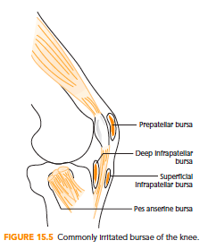
Bursae of the Knee
A bursa is a small fluid-filled sac located at strategic points.
Numerous bursae are in the knee region; only a few are typically injured.

Slide 15
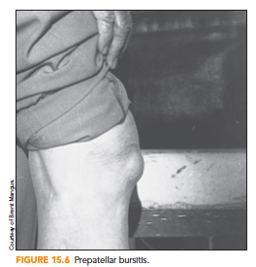
Bursitis of the Knee
Inflammation can be caused by:
Direct Trauma.
Overuse.
Infection.
The prepatellar bursa is most susceptible to direct trauma.

Slide 16
Bursitis of the Knee
Signs and symptoms
Swelling and tenderness at site.
Pain when increased external pressure is applied.
Athlete may report direct trauma to knee.
First Aid
Application of ice and compression.
Reduced activity for a short time.
In chronic cases, anti-inflammatory agents may be helpful.

Slide 17
Osgood-Schlatter Disease
Osgood-Schlatter Disease involves irritation of the patellar tendon complex – chronic inflammatory condition.
Osteochondritis of the epiphysis of the tibial tuberosity
Common in adolescents who experience excessive muscle activity at growth plate.
Constant running and jumping are often causes.

Slide 18
Osgood-Schlatter Disease
Signs and symptoms
Pain and tenderness about the patellar tendon complex.
Swelling in the area.
Decreased ability to use the quadriceps.
If inflammation continues, area over tibial tuberosity may become solid when palpated.
First Aid
Apply ice and compression.
Refer to physician for specific diagnosis.
Until inflammation subsides, rest is important.

Slide 19
Jumper’s Knee
Jumper’s knee is an irritation (tendinitis) of the patellar tendon complex between its attachments on the tibia and the patella.
Common to the athlete who must jump a great deal as part of sports participation.
Typically, the athlete will experience pain at one of three sites within this complex.
Superior or inferior pole of the patella or at the tibial tuberosity.

Slide 20
Jumper’s Knee
Signs and symptoms
Pain and tenderness around the patellar tendon complex that may spread to tibial tuberosity.
Decreased ability to use quadriceps for running or jumping.
Symptoms that worsen with activity.
First Aid
Apply ice and compression.
Refer to physician for possible anti-inflammatory medications
Rest, strengthening, and stretching are helpful.

Slide 21
Meniscus Injuries
Menisci are typically damaged by quick, sharp, cutting movements.
Injury is more likely to occur if the foot is planted firmly on the playing surface.
There are many different types of tears, and they affect each athlete differently.
In some cases, a torn flap of meniscus will get caught in the joint, causing it to lock.

Slide 22
Meniscus Injuries
Signs and symptoms
Pop or snap when the knee was injured.
May not see any significant swelling.
May not be painful.
Loss of ROM.
Athlete may be able to continue participating.
A feeling the knee is “giving out” periodically.

Slide 23
Meniscus Injuries
First Aid
Apply ice and compression.
Have athlete use crutches.
Refer athlete to a physician.
Meniscus injuries do not necessarily have to end an athlete’s playing season or career. New methods of surgery enable many athletes to return to participation relatively quickly.

Slide 24
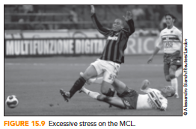
Knee Ligament Injuries
Injury may occur to the MCL, LCL, ACL, or PCL.
Common mechanisms include cutting maneuvers when running and direct blows to the joint.

Slide 25
Collateral Ligament Injuries
Sprain to MCL is a common sports injury.
Occurs as a result of valgus stress.
Sprain to LCL is less common sports injury.
Varus stress can cause a sprain of the LCL.
Both types of sprains render knee unstable in side-to-side movements.

Slide 26
Cruciate Ligament Injuries
Posterior Cruciate Ligament
Injured when the tibia moves forcefully in an posterior direction or when the femur gets pushed forward while the tibia is held in place.
Anterior Cruciate Ligament
Injured when the tibia moves forcefully in an anterior direction or when the femur gets pushed backward while the tibia is held in place.
Quick rotational movements without contact, stops and starts, or awkward landings also injure.

Slide 27
Cruciate Ligament Injuries
Non-contact Anterior Cruciate Ligament Injury
Demonstrated that females encounter more (up to 6X) knee and ACL injuries than their male counterparts.
There appear to be many different reasons why female athletes are more prone to ACL injury.
The stronger the quadriceps activation during eccentric contraction (changing direction & slowing down), the greater the likelihood of ACL injury, especially in female athletes.

Slide 28
Cruciate Ligament Injuries
Non-contact Anterior Cruciate Ligament Injury
Main causes:
Environmental basis including footwear and shoe/surface.
Anatomical rational including: Q-angle, posterior tibial slope, notch width and foot pronation.
Neuromuscular activity including; strength & recruitment of muscle fibers, joint stiffness and muscular fatigue.
Biomechanical rationale with an analysis of the landing techniques.

Slide 29
Cruciate Ligament Injuries
Signs and symptoms
Athlete reports the knee was forced beyond its normal ROM.
Pain at the site of the injury.
Swelling around the knee.
Athlete indicates the knee feels unstable.
Athlete reports having a snapping or popping sensation at the time of injury.

Slide 30
Cruciate Ligament Injuries
First Aid
Immediately apply ice and compression.
Have athlete walk on crutches.
Refer to a physician for medical evaluation.

